Slide 1
Install two-factor verification
To access your accounts more securely, we are introducing an additional security step, two-factor verification, which makes it harder for hackers to break in to your account to access your documents and information. To install it you need your computer and your mobile.
The installation is done in two steps:
Download and install the Microsoft Authenticator app to your mobile
Add your Miun account to your app

Slide 2


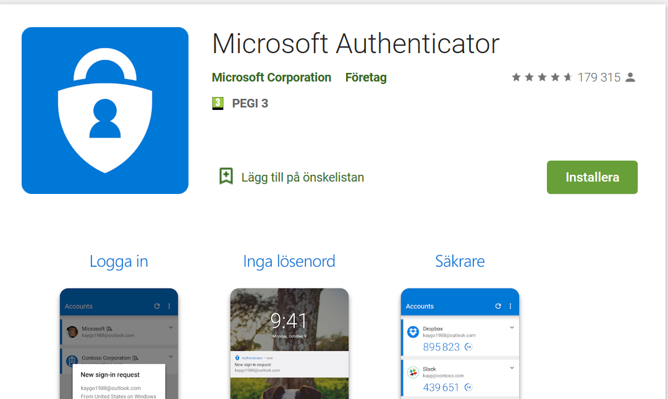
Step 1
Download and install the app Microsoft Authenticator to your mobile
For Apple units: Available in AppStore
For Android units: Available in Play Butik
Give the app access to your camera to photograph a code, as well as your contacts. Save these settings.
When the app is installed on the unit you wish to use to log in, select Next and then Next again in the dialog box ”Configurate your account”.
Select Add account followed by your work or school account.
The app asks you to scan a QR code you will now generate on your computer

Slide 3
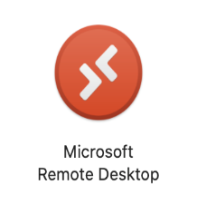
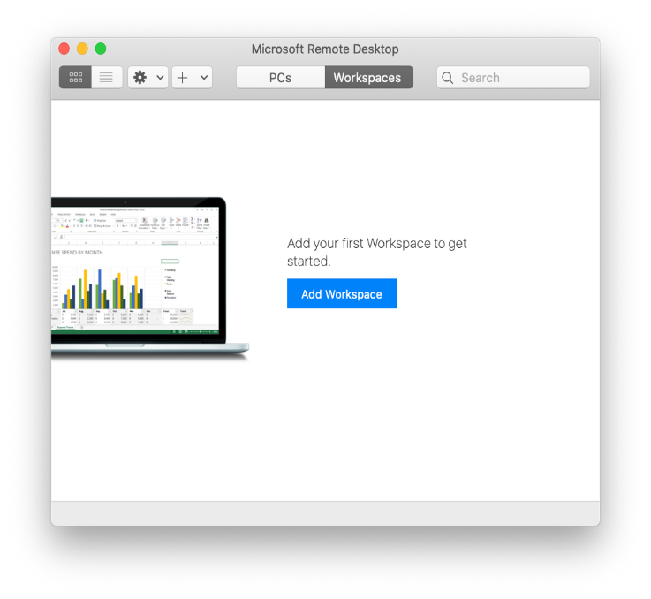
Step 2
  Start Microsoft Remote Desktop (Install from Self Service if needed)
  Click on Add Workspace

Slide 4
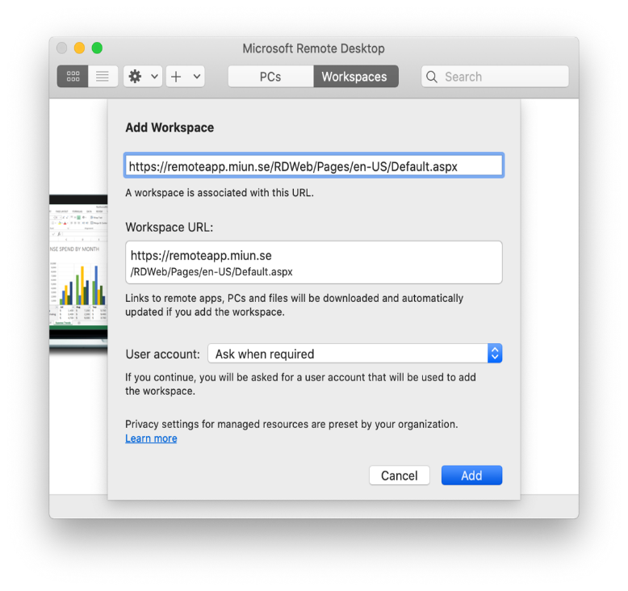
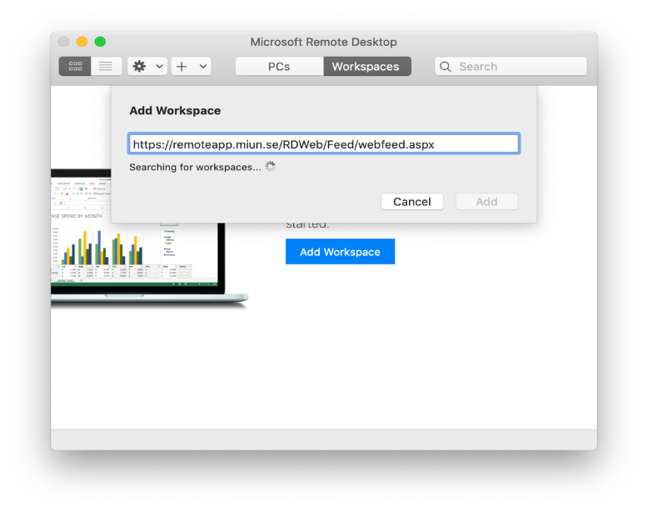
Type the following address and click Add:
https://remoteapp.miun.se/RDWeb/Feed/webfeed.aspx

Slide 5
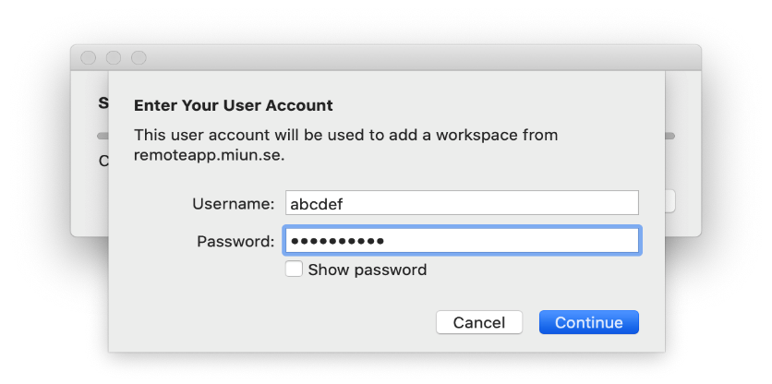
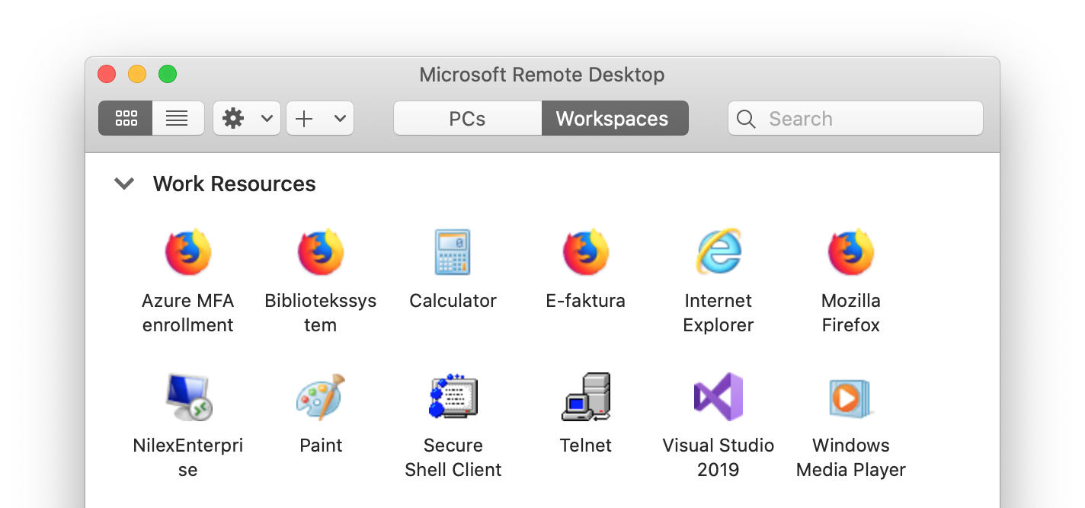
Enter your login information and click Continue.
Here are the apps you can start. Select Azure MFA enrollment.

Slide 6

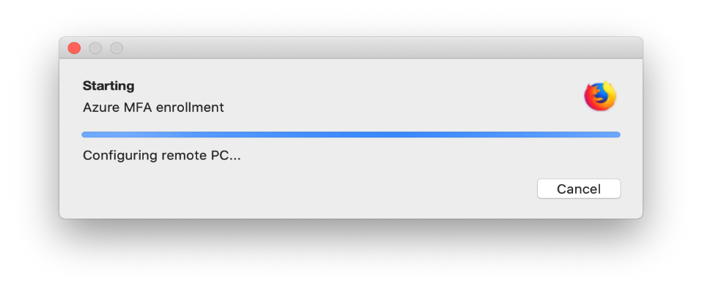
Enter your login information again and press Continue.
A remote desktop will start.

Slide 7
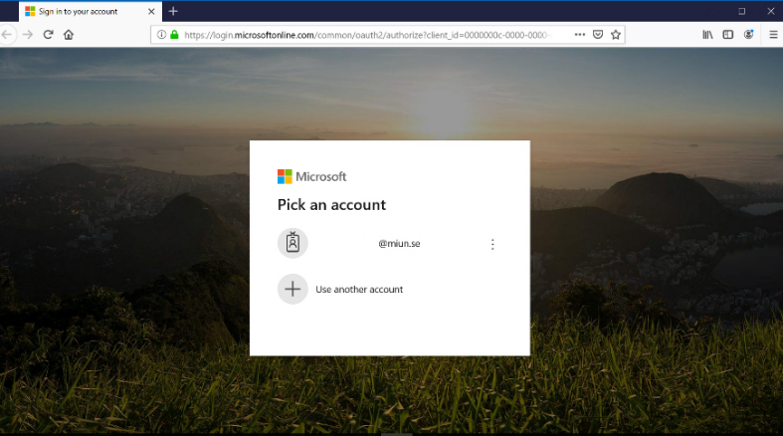
Select your Miun account or enter your Miun email address if your account does not appear.

Slide 8
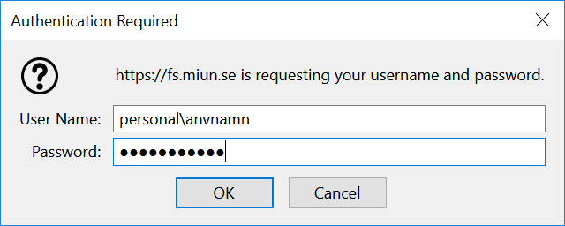
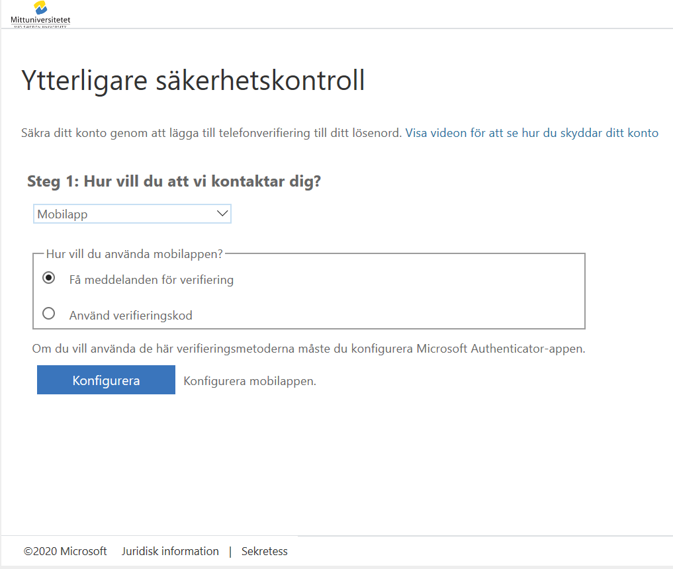
Enter personal\username and password, like when you log in to your computer.
Please note: personal\ must be entered before your user name.
Press the right option key and the ? key for \
Select the option Mobile app as well as Receive notifications for verification.
Select Configurate.

Slide 9
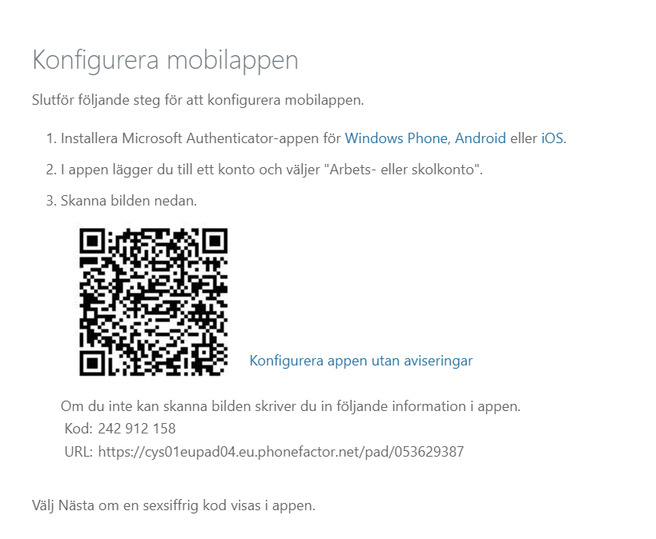
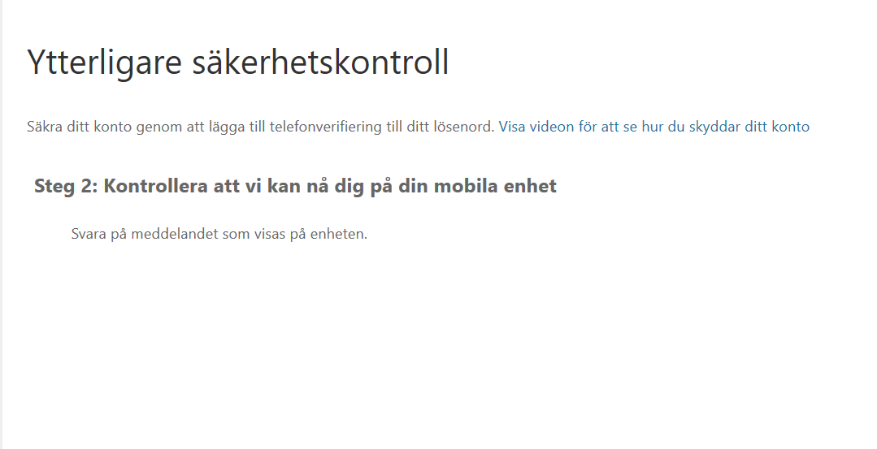
Scan the QR code using the Microsoft Authenticator app on your mobile.
Answer on your mobile unit.

Slide 10
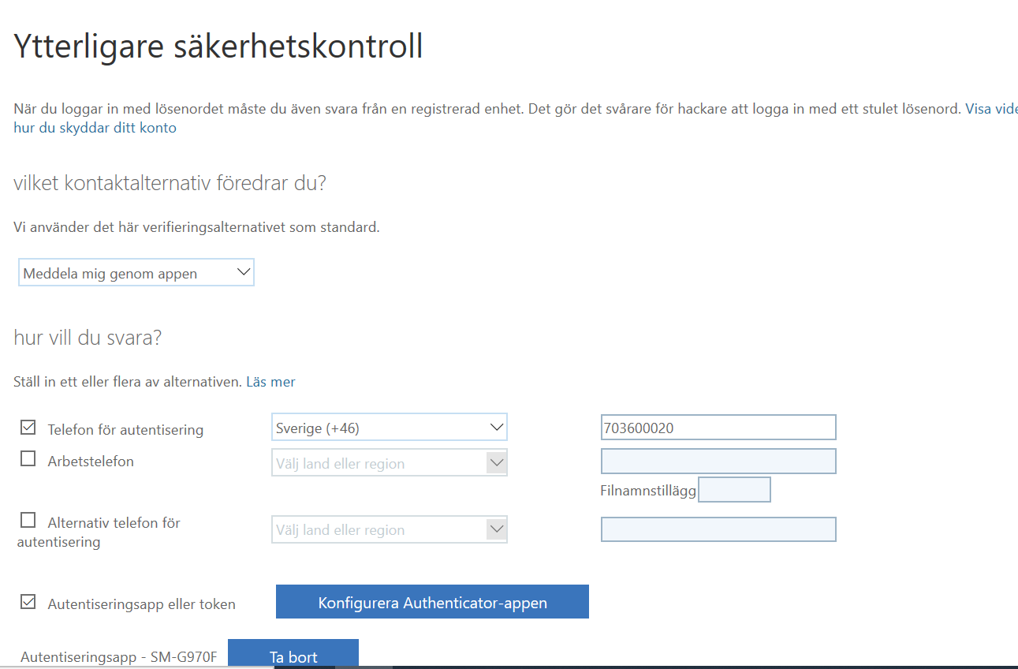
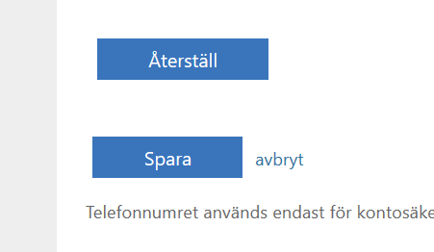
Add your phone number and approve via the app.
Please also add your private phone number in case you lose your work mobile.
Click Save and you are done.

Slide 11
Done!
Should you need help, please contact Helpdesk, +46(0)10-142 80 00

